Slide 1

Empowering The Nation
Educating Domestic Workers and Gardeners for a Brighter Future

Slide 2
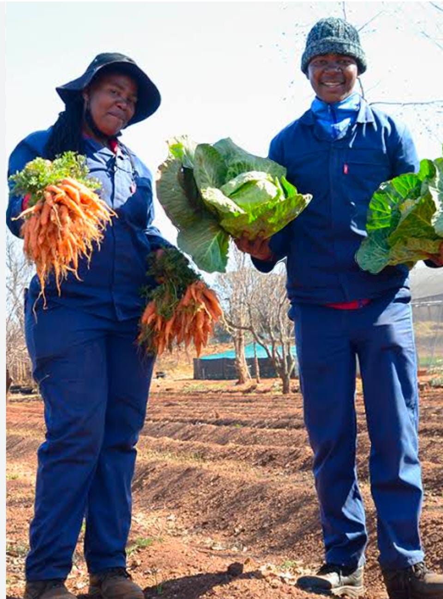
Breaking the Cycle of Limited Opportunities
Domestic Workers and Gardeners Deserve Better
Historically, domestic workers and gardeners have faced significant barriers to education and career advancement.
Statistics:
75% of domestic workers in South Africa have not completed high school (Source: Stats SA)
90% of gardeners lack formal training or certification (Source: Industry Report)

Slide 3
Empowering the Nation: Our Vision
Upskilling Domestic Workers and Gardeners through Accessible Education
Our app provides a comprehensive 6-month program (12 weeks) and short courses (6 weeks) to equip domestic workers and gardeners with essential skills.

Slide 4
Key Features
Comprehensive curriculum covering life skills, financial literacy, and vocational training
Interactive learning modules with videos, quizzes, and assessments
Personalized learning paths and progress tracking
Access to mentorship and community support
Mobile optimization for on-the-go learning

Slide 5
Course Catalog
Empowering Domestic Workers and Gardeners through Practical Skills
Courses listed:
Life Skills: Communication, Time Management, and Conflict Resolution
Financial Literacy: Budgeting, Saving, and Entrepreneurship
Vocational Training: Household Management, Gardening, and Childcare
Short courses: First Aid, Nutrition, and Computer Basics

Slide 6
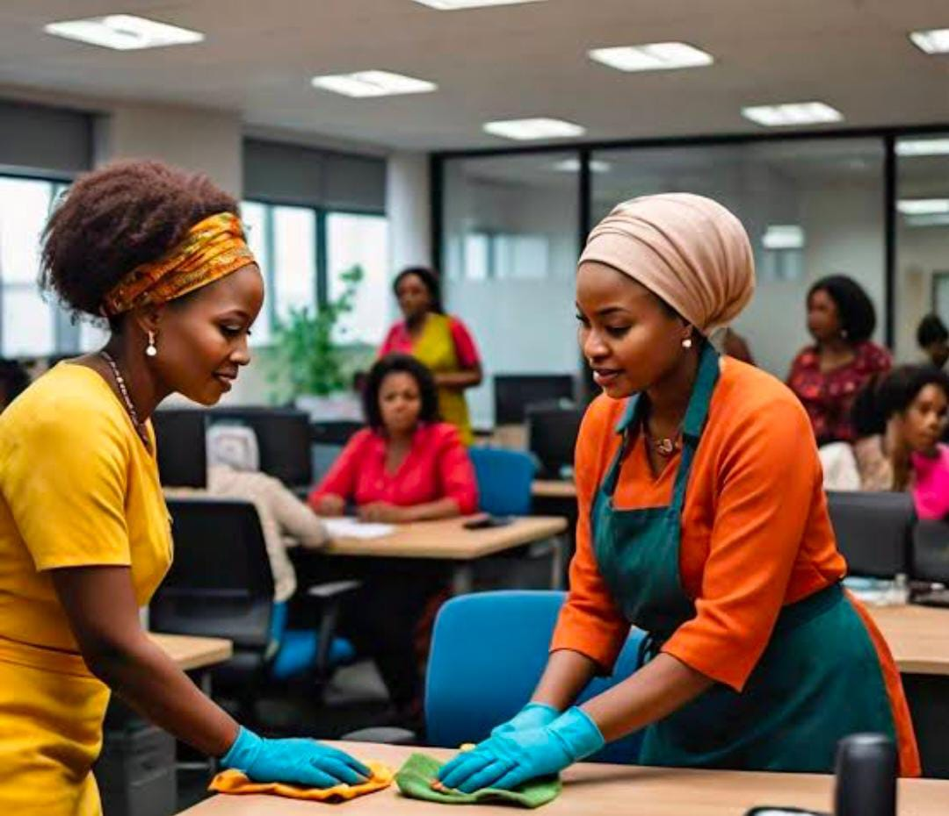
Our Learners
Domestic Workers and Gardeners Seeking a Better Life
Our program caters to domestic workers and gardeners seeking to upskill and improve their socio-economic status.

Slide 7
Why Choose Empowering the Nation
Convenience: Learn anywhere, anytime on mobile devices
Flexibility: Self-paced learning to accommodate busy schedules
Cost-effective: Affordable program fees and scholarship opportunities
Expert instructors: Industry professionals with real-world experience
Community support: Mentorship and peer networking

Slide 8
Real Results
Testimonials:
"Empowering the Nation helped me start my own gardening business." - [Learner's Name]
"I improved my communication skills and now negotiate better wages." - [Learner's Name]
Statistics:
85% of learners reported improved confidence and skills
75% of learners secured better employment or started their own businesses

Slide 9
How It Works
Affordable and Sustainable Education
Our revenue model includes:
Subscription-based access to courses and materials
Partnerships with organizations offering scholarships and funding
Sponsorship opportunities for corporate social responsibility initiatives

Slide 10
Join the Movement
Empower Domestic Workers and Gardeners Today
Call-to-Action button: Visit [website URL] or Download [Empowering the nation]
Contact information: [Email address], [Phone number], [Social media handles]

